Slide 1
AI for game interaction
Results from AI Jam 2024
Notes:
TITLE SLIDE:
Main title & Subtitle always one-liner; must be shortened if too long. Both are mandatory!
Main title always two colored and in uppercase.
Subtitle in italic, mixed case, color: black. (e.g. Presenter, Event, Department, etc.)
Wiki  Guidelines  Basic Slides  The Title Slide
1

Slide 2
TABLE OF CONTENTS
01
Problem
02
Concept
03
Feeding Data
04
Results
05
Conclusion
Notes:
OPTIONAL: „TABLE OF CONTENTS/AGENDA“ SLIDE (up to 5 topics/points):
Use if you have multiple points to cover.
Wiki  Guidelines  Basic Slides  The Agenda/Table of Contents Slide
2

Slide 3
Problem
01
Notes:
„CHAPTER/SECTION BREAK“ SLIDE (with numbers):
Use this slide as section break design if you make use of the “TABLE OF CONTENTS/AGENDA” slide.
Wiki  Guidelines  Basic Slides  The Chapter/Section Break Slide
3

Slide 4
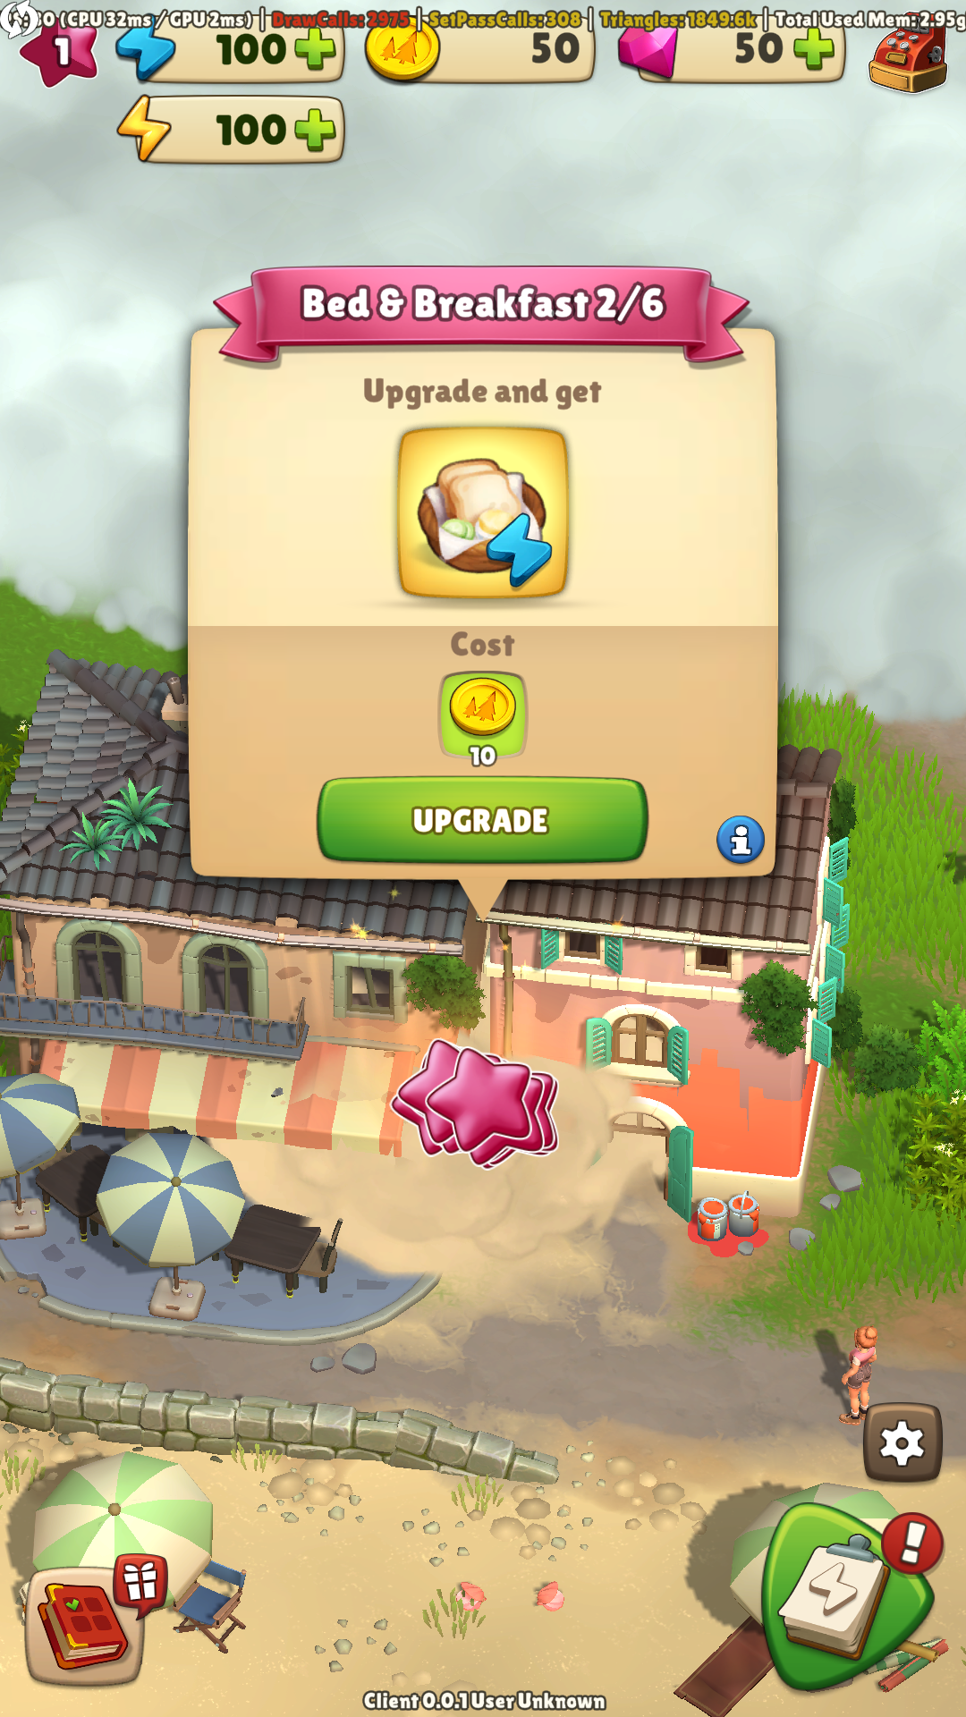
Integration tests don’t adapt
Integration tests need maintenance once written when something changes in the UI
Writing integration tests is tedious and time consuming

Slide 5
Concept
02
Notes:
„CHAPTER/SECTION BREAK“ SLIDE (with numbers):
Use this slide as section break design if you make use of the “TABLE OF CONTENTS/AGENDA” slide.
Wiki  Guidelines  Basic Slides  The Chapter/Section Break Slide
5

Slide 6
Let’s use AI!
1
2
3
AI identifies all buttons with their positions on screen
AI identifies the button that is meant
Position for a click is sent back to Unity
Prompt:
Click on settings button

Slide 7
Feeding Data
03
Notes:
„CHAPTER/SECTION BREAK“ SLIDE (with numbers):
Use this slide as section break design if you make use of the “TABLE OF CONTENTS/AGENDA” slide.
Wiki  Guidelines  Basic Slides  The Chapter/Section Break Slide
7

Slide 8
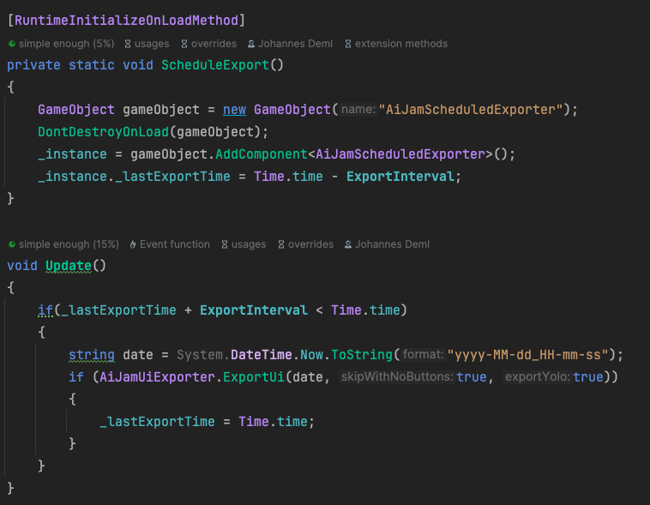
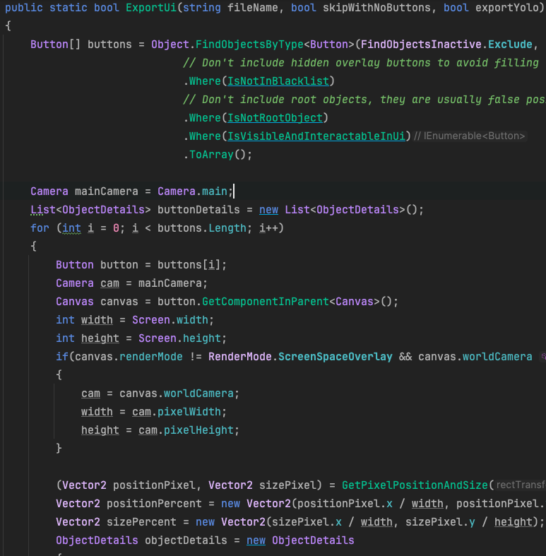
Image Classification for buttons
ChatGPT does not support giving out positions, therefore using YOLOv8
We need to feed in training data and test data to train the model
Not much time, manual work would be tedious and we’re not sure how much we need to get good results
We can get all unity buttons on the screen through script
We have integration tests that already play the game
Let’s take a screenshot every two seconds and save out all valid button positions
Make sure to throw away all disabled and invisible buttons and other things that are not really buttons (backgrounds)

Slide 9
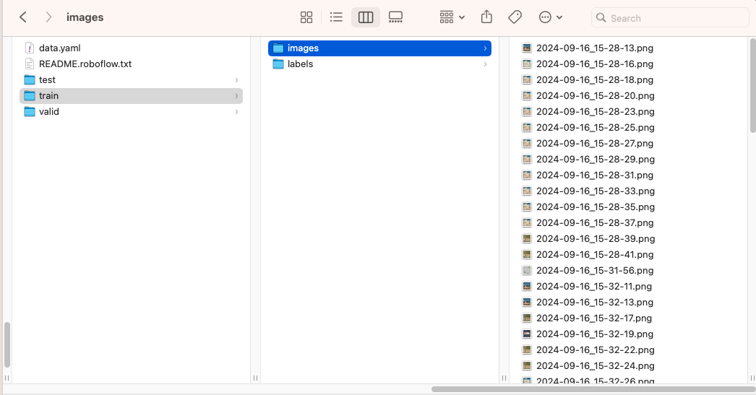
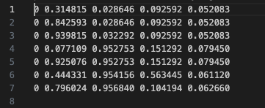
Image Classification for buttons
Next we need to get everything in the right format
And split them into test and training data
In our case:
test: 1 image
train: 82 images
valid: 9 images
Make sure that all images have a size of 640x640
Label format all in percent
Train the data

Slide 10
Results
04
Notes:
„CHAPTER/SECTION BREAK“ SLIDE (with numbers):
Use this slide as section break design if you make use of the “TABLE OF CONTENTS/AGENDA” slide.
Wiki  Guidelines  Basic Slides  The Chapter/Section Break Slide
10

Slide 11

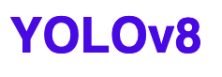
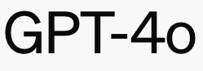
The pipeline
1
2
3
AI identifies all buttons with their positions on screen
AI identifies the button that is meant
Position for a click is sent back to Unity
Prompt:
Click on settings button

Slide 12
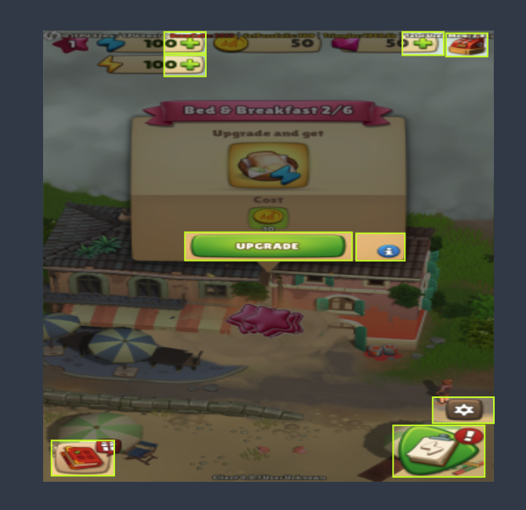
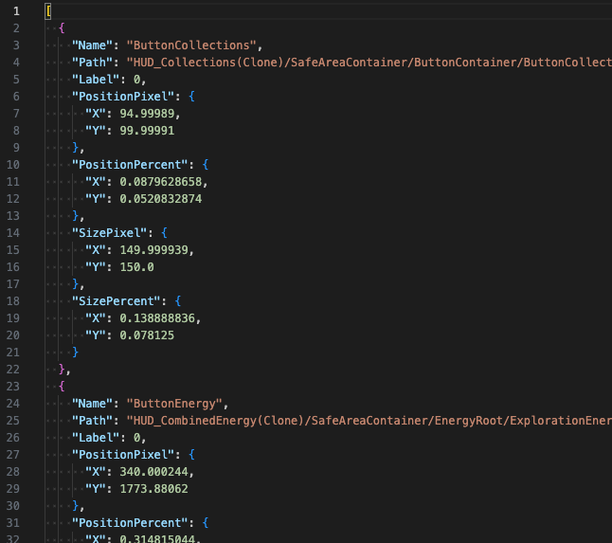
1: identify buttons

Slide 13
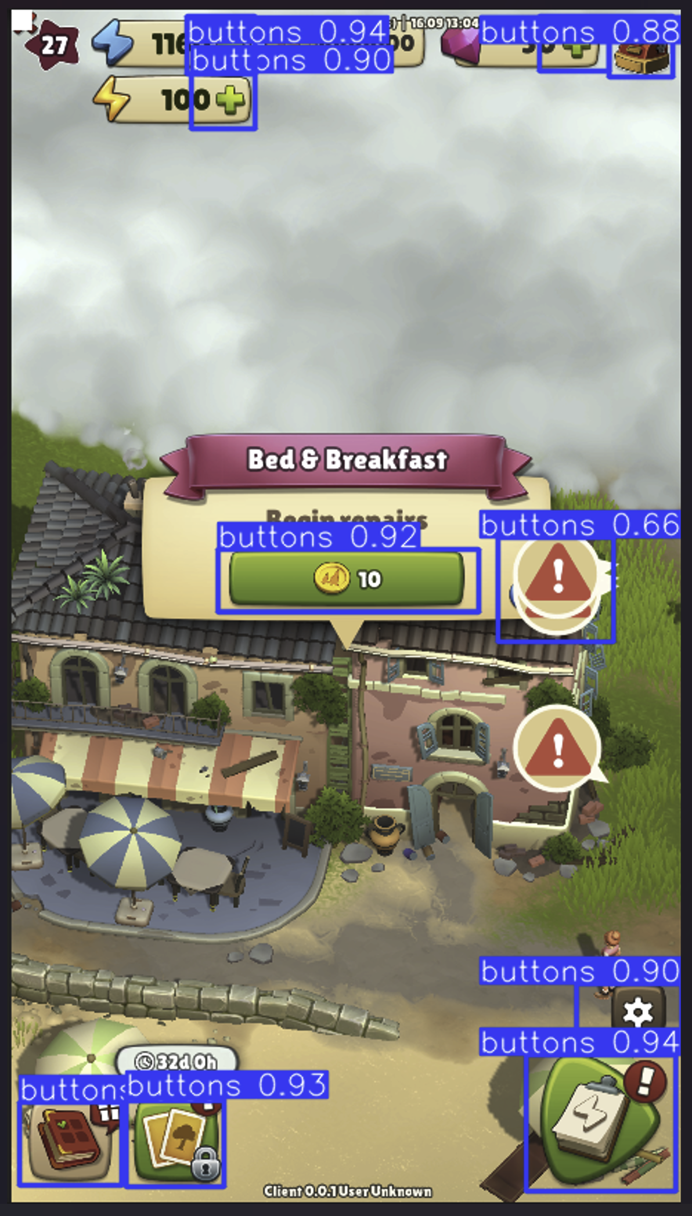
1: identify buttons
Trained model

Slide 14
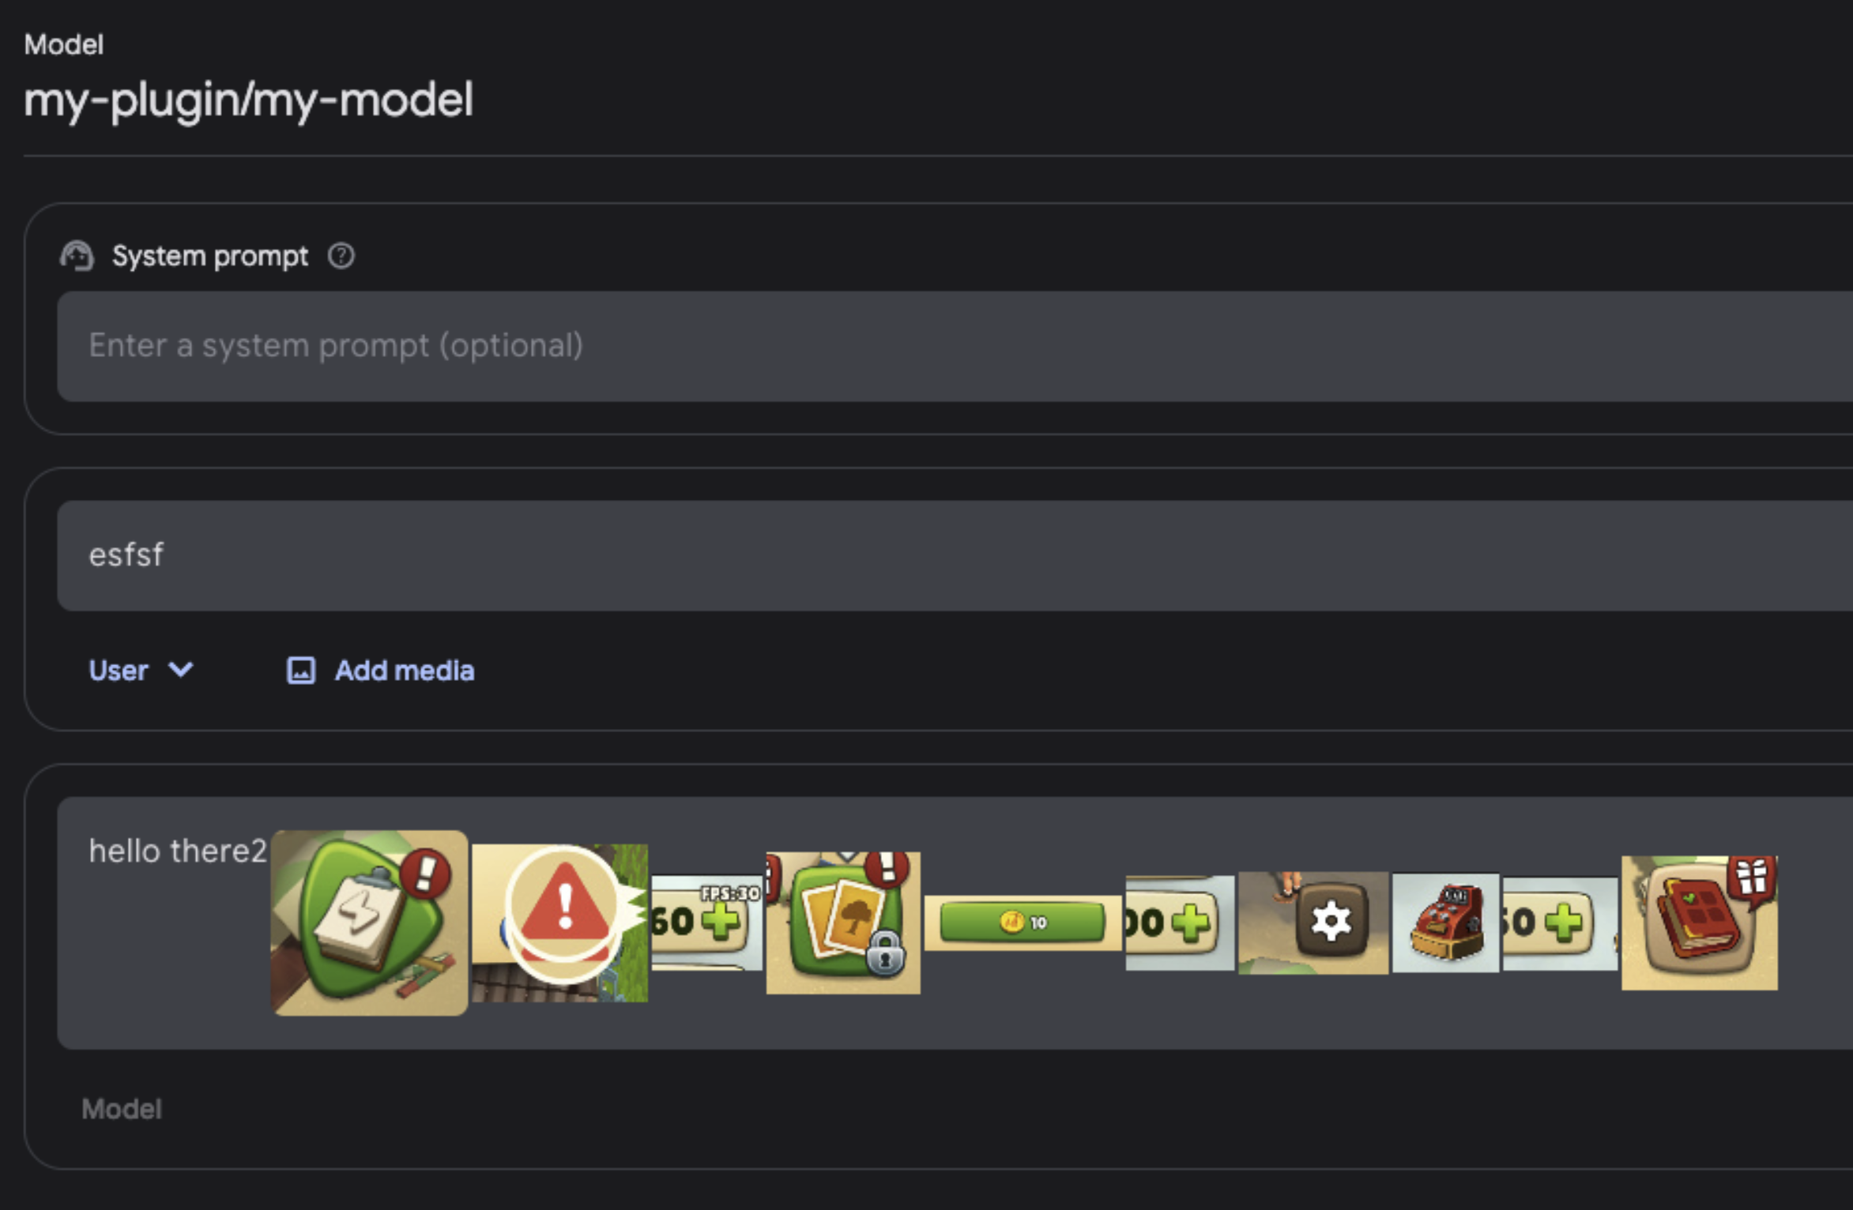
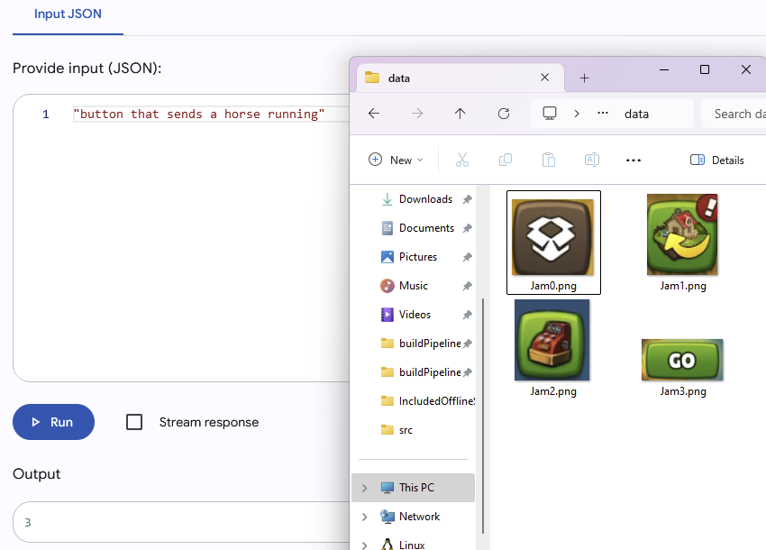
2: Choose correct button

Slide 15
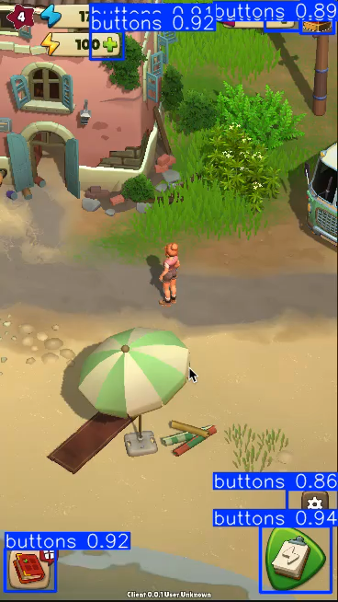
Bonus: Running YOLO on video
32ms processing time per frame on a macbook with M1 pro

Slide 16
Conclusion
05
Notes:
„CHAPTER/SECTION BREAK“ SLIDE (with numbers):
Use this slide as section break design if you make use of the “TABLE OF CONTENTS/AGENDA” slide.
Wiki  Guidelines  Basic Slides  The Chapter/Section Break Slide
16

Slide 17
Conclusion
Generating data set through script was a good decision
Classification is quite powerful (prototype used only one label)
Would be too expensive to run each time, but the results of the found positions could be stored and used until the test fails again
Didn’t get it all working in 1 day but was real fun!

Slide 18
END OF PRESENTATION
Notes:
Thank You/End slide
Headline mandatory (2-colored (yellow & white))!
- Alternate wording for headline: e.g. „You‘re great!“, „That‘s it for now…“, „End of presentation“
18

Slide 19

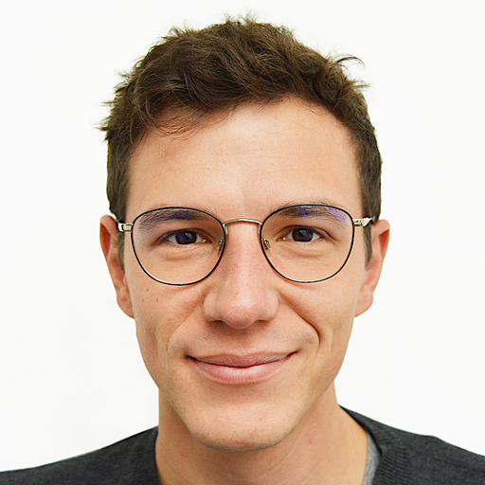

GET IN TOUCH
Finn Kasulke
Senior Quality Assistance Engineer
Johannes Deml
Senior Frontend Developer
Robin Vonsien
Senior Frontend Developer
Notes:
Contact Slide Example 2 Persons (Simple)
19

